Slide 1

LING 124 Week 2: Reference and tracking in Rezonator
John W Du Bois & Ryan Ka Yau Lai

Slide 2
Let’s review last weeks’ shows first!

Slide 3
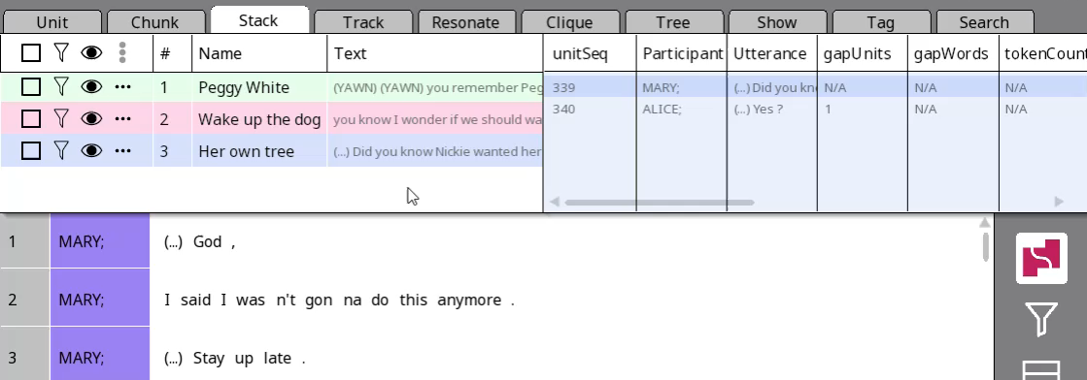
Showtime!
Right-click on each of your three question-answer pairs
Add them to a show with ‘Add to show’ (you need to create a show the first time
Go to the Show tab, use the Play button to play the show!

Slide 4
Yesterday we’ve gone through the notion of referring.
How can we investigate how speakers refer in Rezonator?

Slide 5
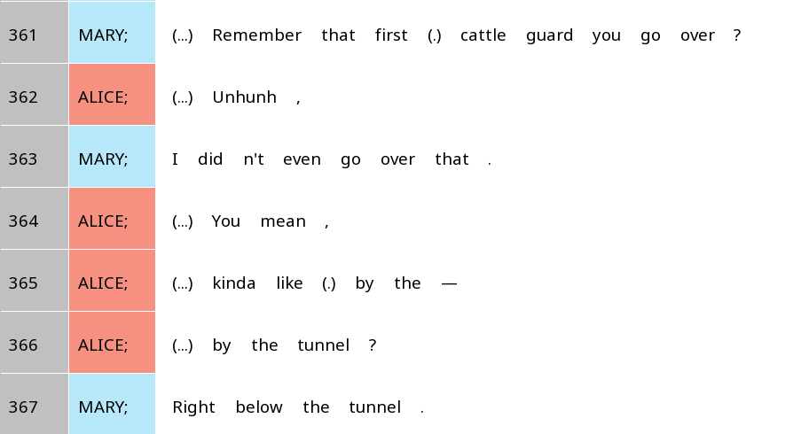
Can you spot some referential expressions here?

Slide 6
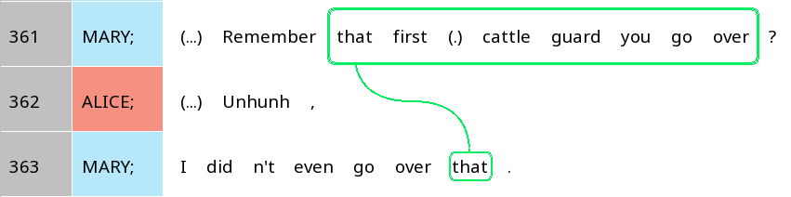
Marking up referential expressions in Rezonator
Trail
Track
Track

Slide 7


Linguistic terminology vs. Rezonator terminology
Linguistic terminology | Rezonator terminology
Intonation unit (in this class) | Unit
(Word) token | Token
Coreference chain | Trail
Mention, referential expression | Track

Slide 8
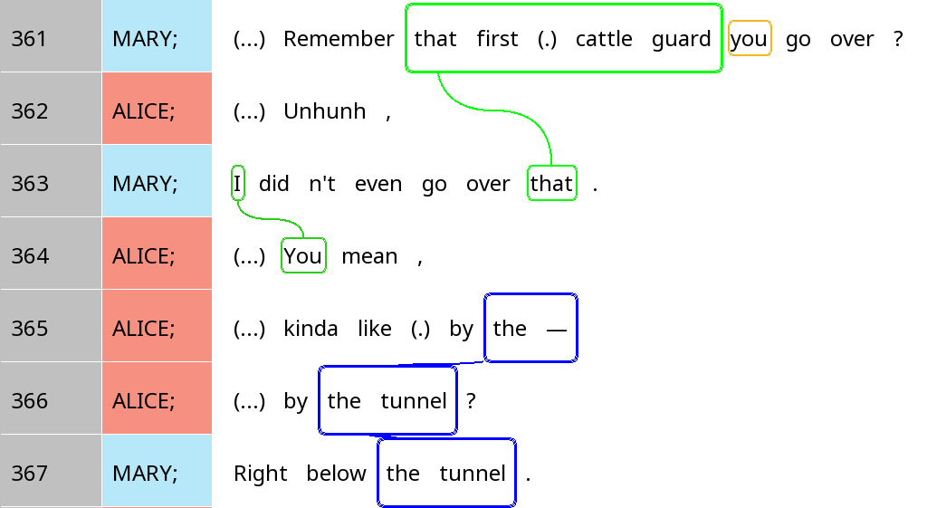
The excerpt at the beginning (again)

Slide 9



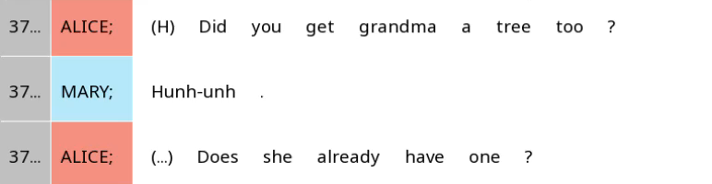
Creating trails
Make sure you are in Rez mode (first button on the sidebar, middle option)
For multi-token tracks (a tree), draw a box around it to add it to the trail
For single-token tracks, just click on it to add it to the trail
Press Esc. to exit the currently active trail
1.
2-4.

Slide 10


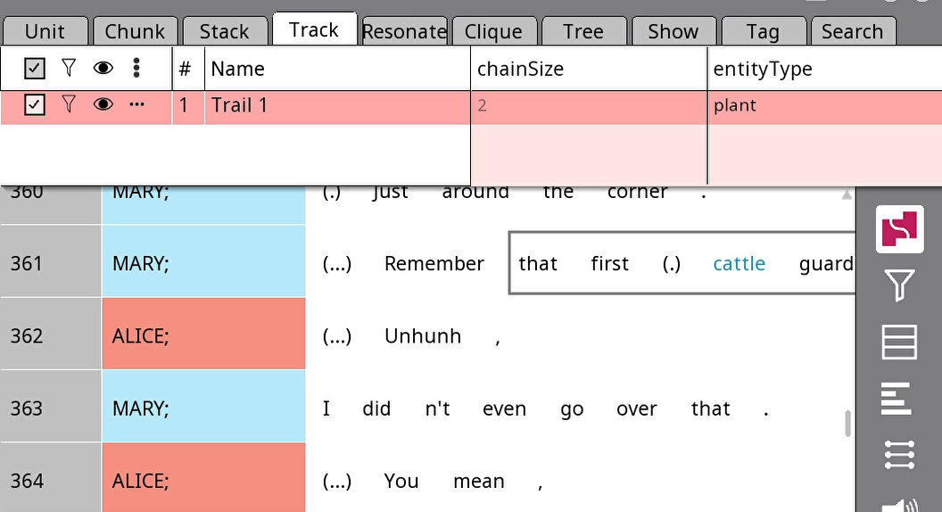

Renaming trails
This is exactly the same process as renaming stacks!

Slide 11
Your turn!
Select ~10 lines from the text where at least two entities are mentioned
Create two trails and name them (e.g. Alice, the cattle guard)

Slide 12
Examining coreference chains
Why are two different referential expressions used for the same entity?

Slide 13
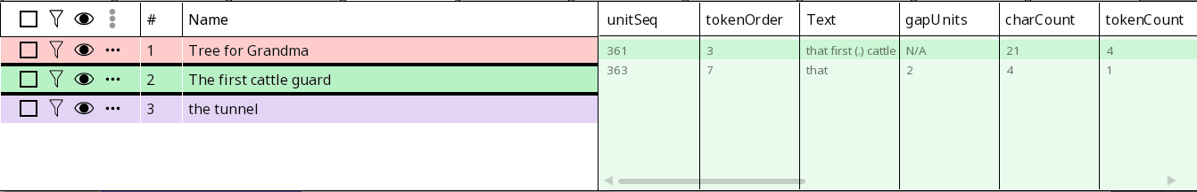
Understanding the nav window
unitSeq: Unit sequence
gapUnits: Number of units since the previous mention
Number of units since the previous mention
Unit sequence
How are these related to accessibility?

Slide 14
Understanding the nav window
charCount: Number of characters
tokenCount: Number of tokens
# of characters
# of tokens
How are these related to accessibility?

Slide 15
Shorter distance from previous mention (track)
Shorter referential expression
Higher accessibility
Larger number of previous mentions (farther along in trail)
Less specific referential expression
…
Any more you can think of?

Slide 16
Factors related to accessibility (in English)
Context | Properties of current mention | Inherent properties of referent
Shorter distance from previous mention (track) | Current grammatical role is subject | Animate, esp. human
Larger number of previous mentions (farther along in trail) | … | Women (Misogyny > Less perceived need to be clear about women’s identity)
Fewer competitors |  | Singular
Previous grammatical role is subject |  | …
…
How might these be represented in Rezonator?

Slide 17
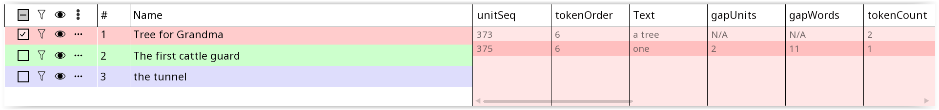

One-to-one vs. one-to-many
One-to-many: One trail – Many tracks
One-to-one: One trail – One trail

Slide 18
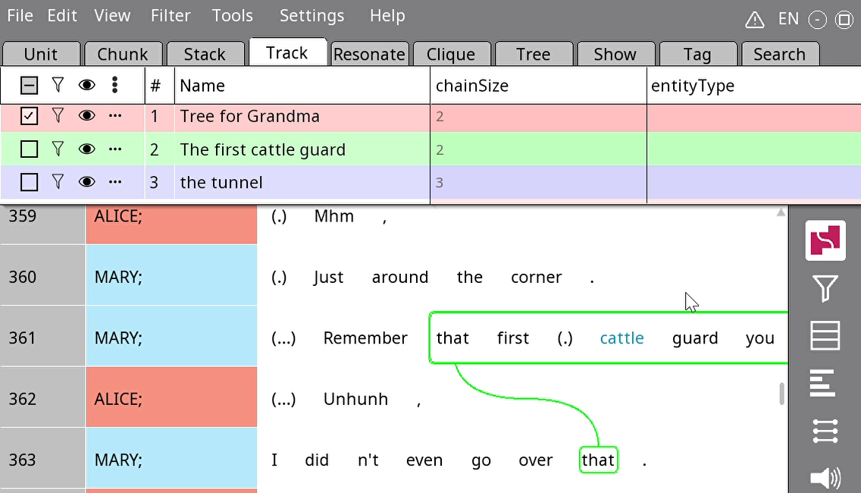
Changing the entity type of trails
Field
Tags

Slide 19
Your turn!
Find two referents that are mentioned at least four times: One animate (i.e. human/animal), one inanimate
Create two trails and observe how the length of individual mentions (tracks) change over the course of the trail
Once you’re done, share with your partner what differences you found!

